Slide 1
Ticketing Software DEVELOPMENT PROCESS
OCTOBER 9, 2022

Slide 2
Glossary
Introduction
Development Process
Conceptualization
Design
System Organization
Tech Stacks to Use
Output – For Development Stage One
Testing
Summary

Slide 3
Introduction
System development often referred to as the application development life cycle, is the architecting of the system via planning, creating, testing, and deploying it as well.
In this presentation, we shall discuss our system development process in stage one, as well as the full plan of the system thereof.

Slide 4
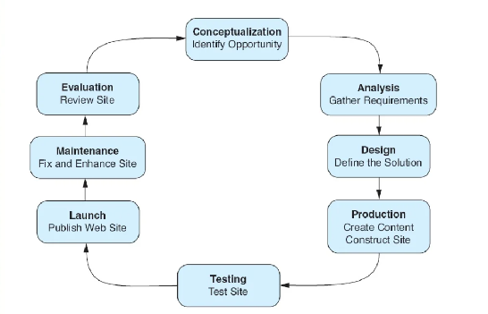
Development Process

Slide 5
Conceptualization
Target Audience:
- Corporate market
- Social Market
Goals:
Short Term Goals:
    Speed up the process of ticket issuance and ensuring an efficient process.
Long Term Goals:
Track, manage, and automate event booking with the issuance of tickets. Efficient practice is the core goal for the proposed system.

Slide 6
Design
Site structure for the proposed system will be based on authentication per user.
The system will have several pages pertaining to achieving the intended proposed solution needed.
The prototype of the system is simple and concise. We shall have a Login page, Signup page for administrators, Forgot password pages and main pages that dashboard will hold depending on the modules proposed.

Slide 7
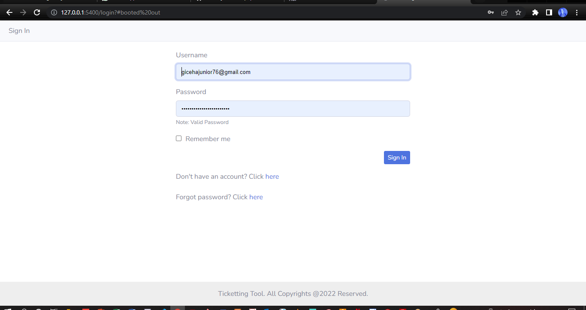
Ready Prototype System Pages
Fig 1.1: Login Page

Slide 8
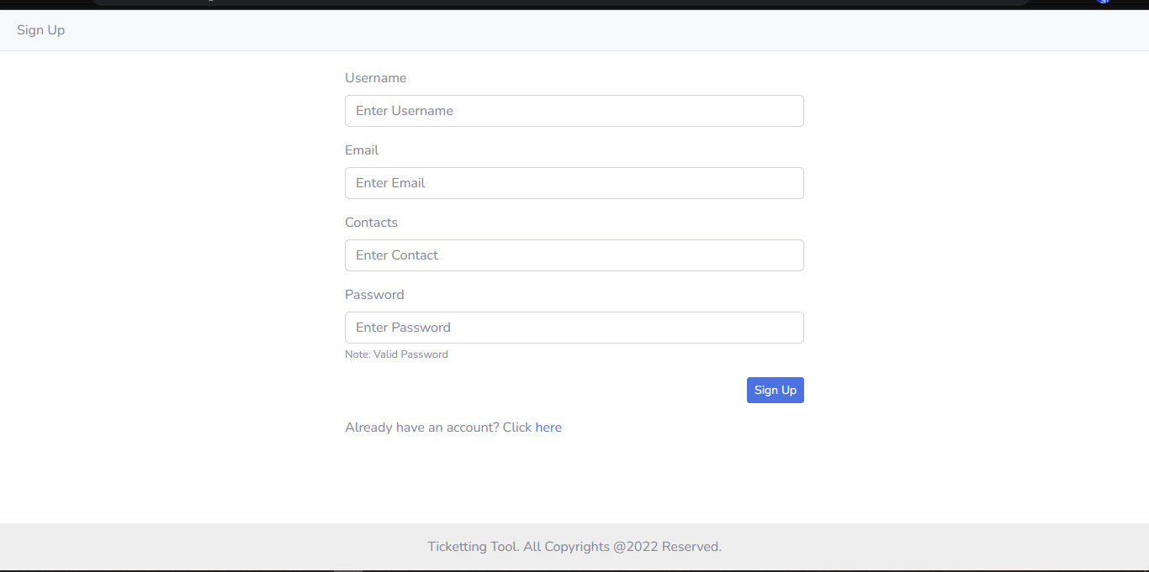
Fig 1.2: Signup Page

Slide 9
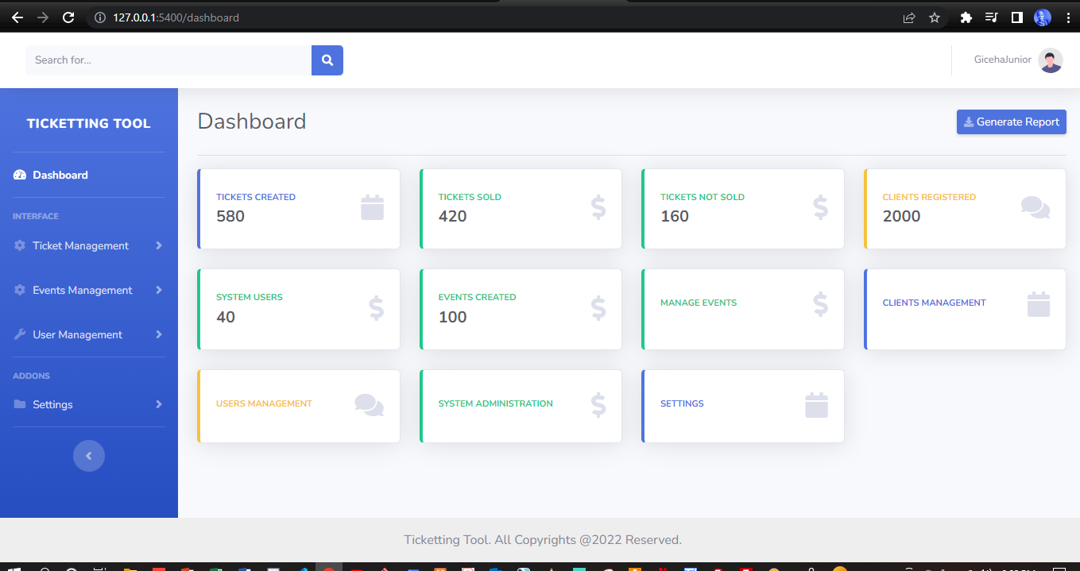
Fig 1.3: System Dashboard UI

Slide 10
System Organization
Hierarchical Organization
Linear Organization
Random Organization

Slide 11
Hierarchical Organization

